Slide 1

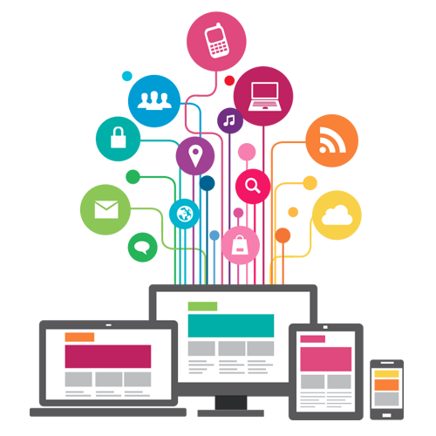

Technologies of Information and Communication (TIC)
BABAALI Manel

Slide 2
Contents
Components of ICT
Technologies related to TIC
Introduction
History of ICT
Challenges and Limitations of ICT
Benefits of ICT
Examples of ICT Applications
Future Evolution of ICT
Key Statistics
Conclusion
References

Slide 3

Introduction
Information and Communication Technologies (ICT): Refers to a broad range of technologies that provide access to information through telecommunications. This includes all types of technologies used for managing, processing, and communicating information.
Importance of ICT in Modern Society
Central Role: ICT is crucial in the digital transformation of businesses, governments, and society as a whole.
Impact: It drives innovation, enhances productivity, and facilitates global communication, making it an essential component of modern life.
3

Slide 4
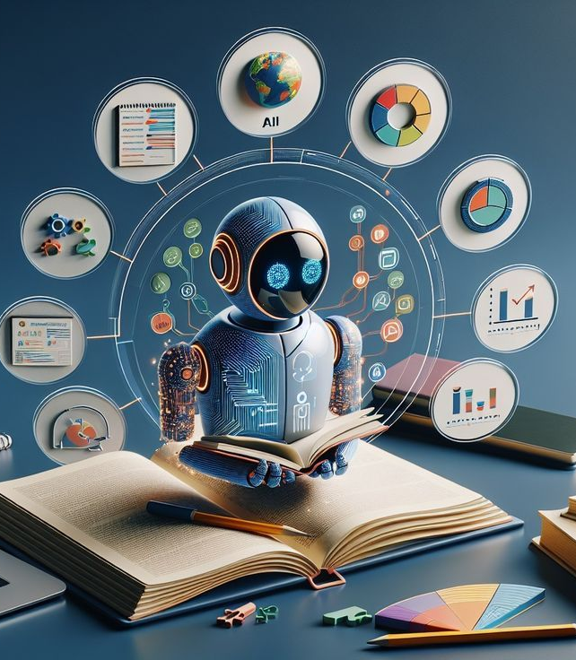
Understanding ICT: The goal is to explore the history, components, benefits, challenges, and future trends of ICT to gain a comprehensive understanding of its significance.
Objectives of the Presentation

Slide 5
History of ICT
Early Information Systems (1950s-1960s): Focused on calculation tasks and basic information storage, laying the groundwork for modern information systems.
Emergence of the Internet (1980s-1990s): Connected universities and businesses, leading to the development of the World Wide Web.
Web 2.0 and Social Networks (2000s): Introduced user-generated content and social media, revolutionizing communication and information sharing.
Impact of Mobility and Cloud Computing: Enhanced accessibility and flexibility, allowing users to work and access information from anywhere.
5

Slide 6
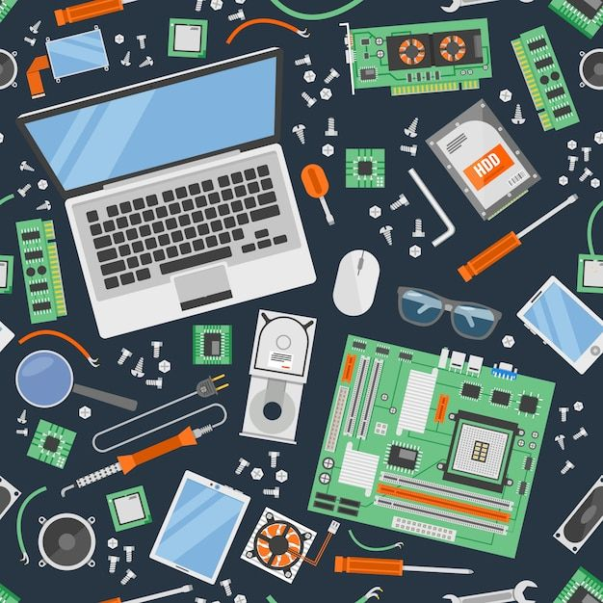

Components of ICT
Hardware: Includes physical devices such as computers, smart phones, and networking equipment.
Software: Encompasses operating systems, applications, and web services that facilitate information processing.
Networks and services: Covers internet services, social media platforms, and telecommunications services that connect users.
6

Slide 7

Technologies related to TIC
Google Services: Includes Google Drive, Docs, Sheets, Slides, Workspace, Cloud Platform, Classroom, and Analytics for collaboration and productivity.
Microsoft Tools: Comprises Office Suite (Word, Excel, PowerPoint), Teams, OneDrive, Azure, Visual Studio, and Power BI for various productivity and development tasks.
Git: A distributed version control system for tracking code changes, enabling collaboration and offline work.
GitHub: A web platform for Git version control, offering repository hosting, collaboration tools, CI/CD automation, and project management.
These technologies enhance productivity and collaboration across various sectors.
7
Technologies of Information and Communication (TIC)

Slide 8

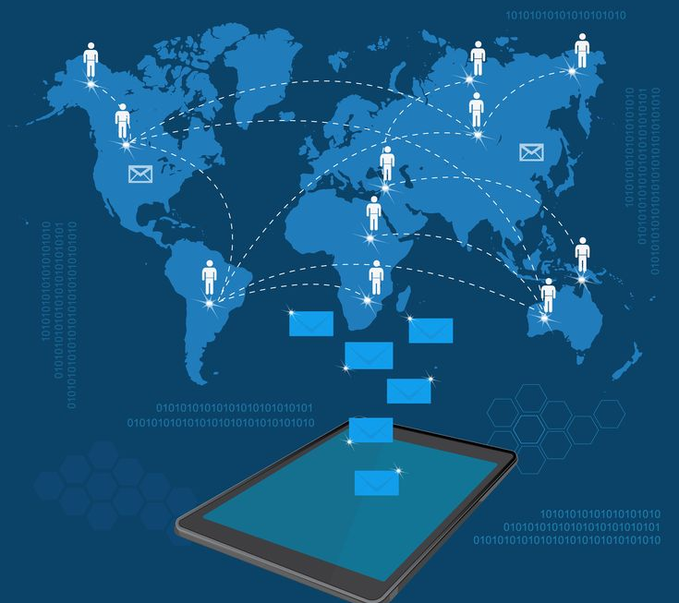


Enhanced Communication: Facilitates instant communication across the globe. Increased Productivity: Streamlines processes and improves efficiency in various sectors. Economic Development: Contributes to growth by enabling new business models and markets.
Benefits of ICT
8

Slide 9
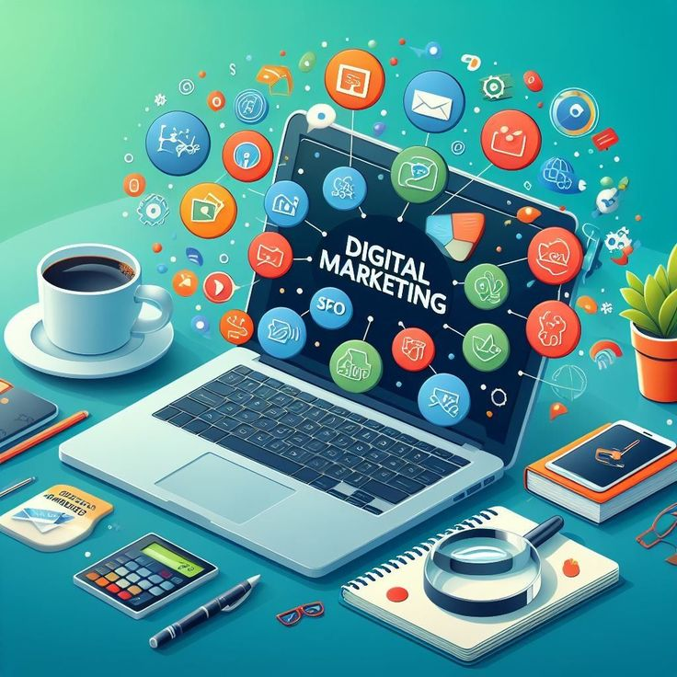
Examples of ICT Applications
E-Learning: Online platforms facilitate education from any location.
Telecommuting: Remote work is supported by cloud technologies and communication tools.
E-Commerce: Online shopping has transformed the retail landscape.
Digital Health: Telemedicine and health applications enhance patient care.
E-Governance: Governments offer online services and communication with citizens.
9

Slide 10
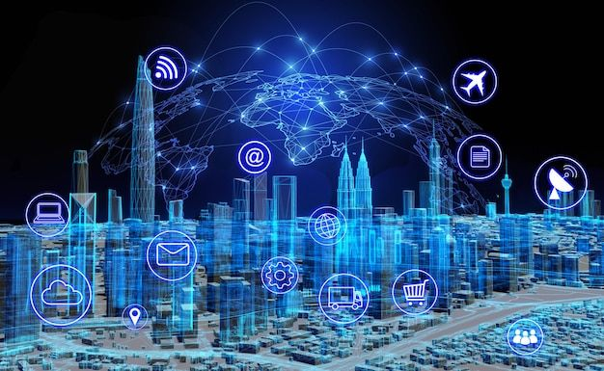



Challenges of ICT
Digital Divide: Disparities in access to technology and the internet among different populations.
Cyber security: Risks associated with data breaches and online threats.
Data Privacy: Concerns regarding the protection of personal information.
Infrastructure Needs: Requirement for robust infrastructure to support advanced technologies.

Slide 11
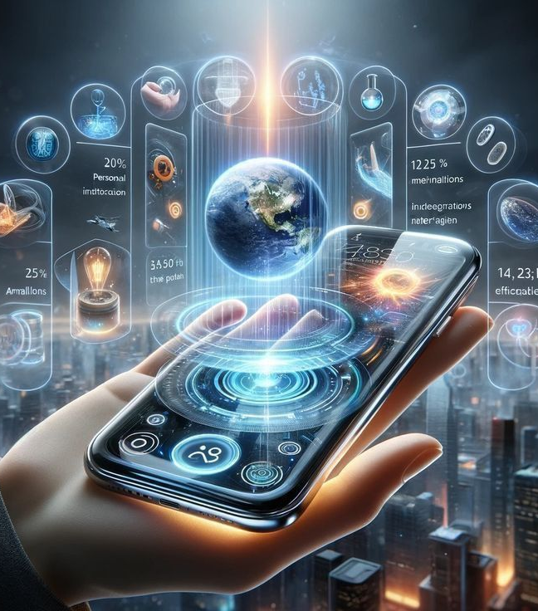
Future Evolution of ICT
Artificial Intelligence (AI): Enhances decision-making and automates tasks across various sectors.
Internet of Things (IoT): Connects devices to create smarter homes and cities, improving efficiency.
Virtual and Augmented Reality (VR/AR): Provides immersive experiences for entertainment and education.
5G Networks: Enables faster, more reliable connectivity for advanced applications.
Cloud Computing: Offers flexible, scalable services that enhance collaboration and productivity.
These advancements will integrate ICT into daily life, making it essential for communication, automation, and societal interactions.
Technologies of Information and Communication (TIC)

Slide 12


Key Statistics
Number of Internet Users: 4.9 billion worldwide in 2022.
Mobile Penetration Rate: 67% globally in 2022.
ICT Market Projection: Expected to reach $6,000 billion by 2025.
These statistics highlight the significant reach and growth potential of ICT globally.
12

Slide 13
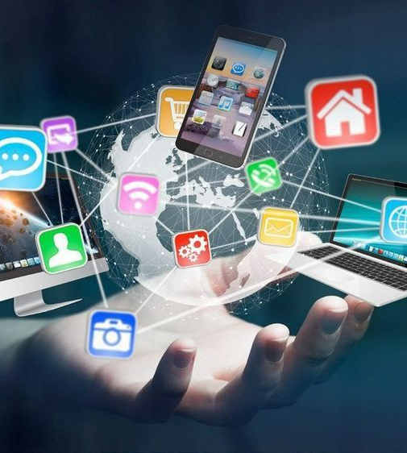
Conclusion
ICT has significantly impacted communication, productivity, and global interconnectedness, driving innovation and societal change, with a future focused on more advanced technologies.
13

Slide 14
References
Organization for Economic Co-operation and Development (OECD)
Official websites of ICT companies
International Telecommunication Union (ITU)
Gartner
IDC
14

Slide 15

Thank you for your attention
Technologies of Information and Communication (TIC)
E-mail: BABAALI.Manel.242431413401@gmail.com
Student in USTHB University/L1/SIGL

